Slide 1
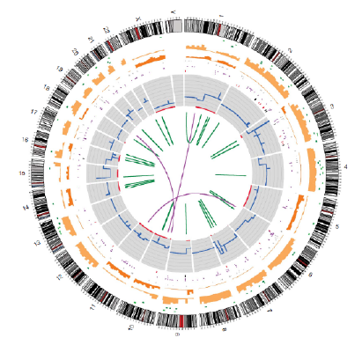
Genomic Structural Variations In Human Cancer (GSVIHC) Database
Cancer is a genomic disease characterized by a wide range of structural variations
In the genetic and epigenetic compliment of the disease cell.
Structural variations include DNA base substitutions, small insertions/deletions,
copy number variations, severe chromosomal translocations, and changes in DNA
methylation patterns.
A cancer’s catalog of structural variations evolves as the
disease progresses, goes into remission, or spreads to
another tissue type (metastasis).
The rapidly decreasing cost of NGS has
made genomic analysis an important
tool in cancer treatment

Slide 2
GSVIHC Requirements
Support the disease model of cancer as a dynamic and evolving pathology
Support the correlation of clinical findings with genomic analysis
Support the robust annotation of genomic analysis data
Support data from new genomic analysis technologies
Comply with relevant patient data privacy regulations

Slide 3
GSVIHC Design Features
GSVIHC supports access to data in two overlapping perspectives: clinical and scientific
  Clinicians can use genomic analysis information to optimize patient treatment
  Scientists can use the same data to understand cancer’s impact upon normal cellular pathways
Extensibility
  Annotations
  Clinical notes
  External References
Application level enrichment

Slide 4
GSVIHC Design Concepts
Two major sections
  Patient-related data
    Biopsy results
    Clinical notes
  Structural variation data
    Highly detail descriptions of known structural variations
Joined by a catalog of structural variations observed in a patient biopsy
Data is strongly typed
Use of ontologies for controlled vocabularies
Not gene-centric

Slide 5
GSVIHC Implementation
MS SQL Server 2008 R2 and MS SQL Azure (p4vnzoerz7.database.windows.net)
Oracle SQL Developer Data Modeler for relational model
MS SQL Server Management Studio for database implementation

Slide 6
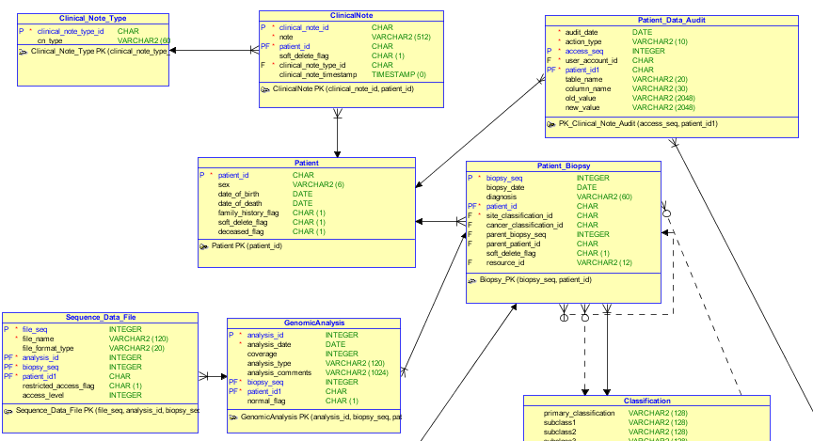
Patient-related entities

Slide 7
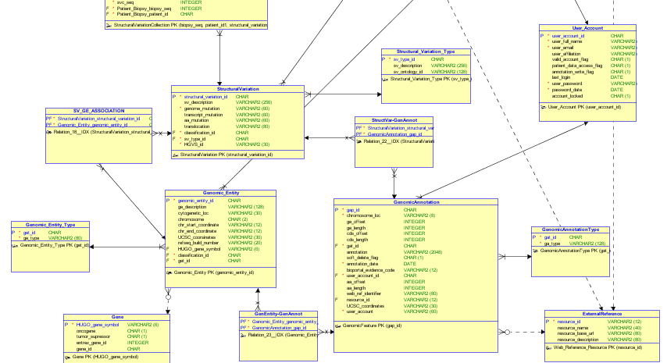
Genomics related entities

Slide 8
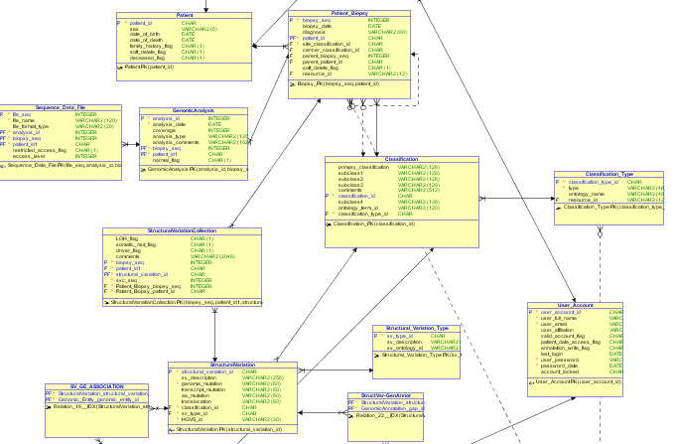
Structural Variation Catalog section

Slide 9
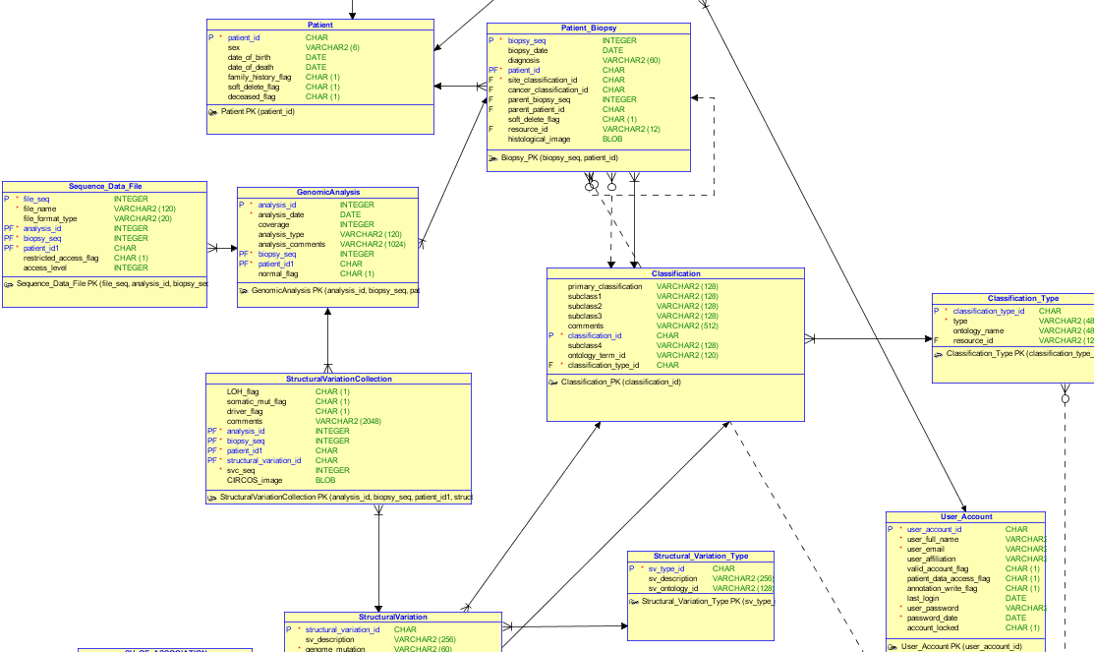
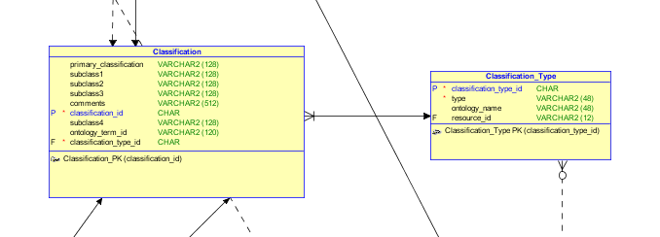
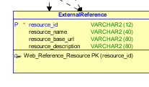
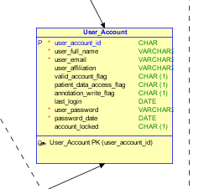
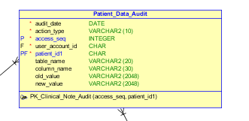
Support entities
Classification
External Reference
User Account
Patient Data Audit

Slide 10
Future Enhancements
More robust security implementation
Enhance patient information
Journal queries of patient-related data
Integration with protein structure data

